Slide 1

Project Title -Seasonal Agriculture Performance Analysis
Student Name – Shubham Kumar
College Name- GNA University
AICTE STU ID : STU6a5dbbaa8f0a01784527786

Slide 2

PROBLEM STATEMENT
Agricultural performance is influenced by seasonal conditions, environmental factors, farming practices, resource utilization, and market conditions. Raw agricultural data do not clearly show how productivity, production, profitability, and resource usage vary across different seasons, crops, states, and districts.
Therefore, this project analyzes agricultural data to identify meaningful patterns, relationships, variations, and differences in agricultural performance and to support data-driven agricultural decision-making.

Slide 3
Project Description
This project performs an exploratory data analysis of agricultural performance using Python. The dataset contains 4,000 agricultural records and 28 variables covering farm characteristics, environmental conditions, farming practices, crop performance, resource utilization, and economic outcomes.
The analysis examines agricultural performance across seasons, crops, irrigation methods, states, and districts. Statistical calculations, correlation analysis, and data visualizations such as bar charts and scatter plots are used to identify important patterns and relationships.
The main outcomes analyzed include yield, production, revenue, profit, water usage, water efficiency, disease and pest risk, and market price.

Slide 4

WHO ARE THE END USERS?
Farmers
Optimise field-level outcomes by comparing crop performance, identifying profitable yields, evaluating irrigation practices, and maximizing resource efficiency.
Agricultural Departments
Drive regional development by identifying high- and low-performing zones, monitoring seasonal yields, and supporting targeted public agricultural planning.
Agricultural Planners & Consultants
Guide data-driven stakeholder decisions through longitudinal trend analysis, productivity-profitability comparisons, and seasonal evaluations.
Data Analysts & Researchers
Advance agricultural intelligence by studying complex spatial patterns, executing statistical analyses, and developing predictive crop models.
Agribusiness & Decision Makers
Inform strategic investments and corporate planning by tracking revenue streams, assessing production yields, and pinpointing lucrative crops.

Slide 5

Technology Used
Python Programming language used for data analysis.
Pandas Used for data loading, cleaning, grouping, aggregation, and analysis.
NumPy Used for numerical and mathematical operations.
Matplotlib Used to create bar charts and scatter plots.
Seaborn Used for statistical visualization and graphical analysis.
Jupyter Notebook Used as the development and analysis environment.
CSV Dataset Used as the source agricultural dataset.
Aapke notebook mein Pandas, NumPy, Matplotlib aur Seaborn explicitly imported hain.

Slide 6
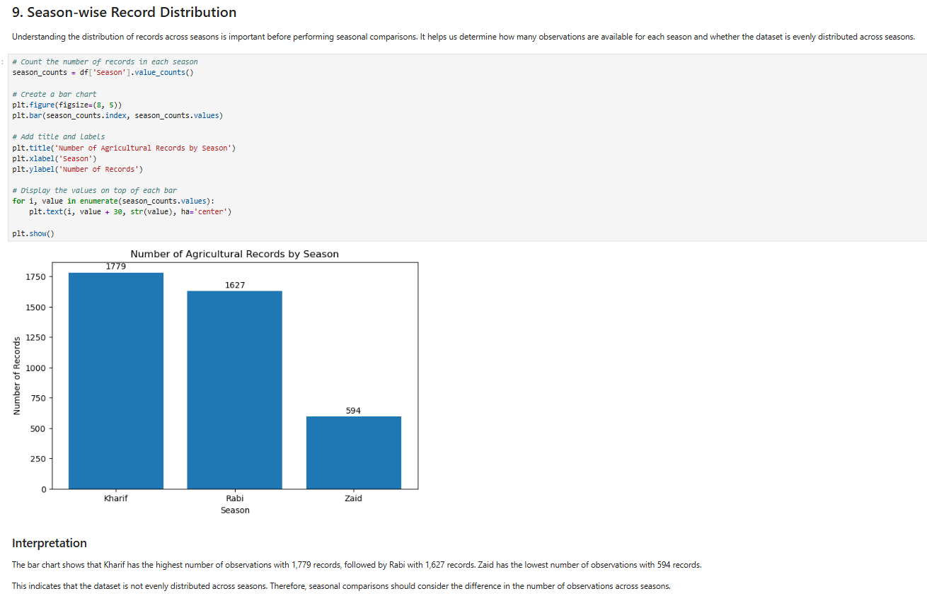
RESULTS
The bar chart shows that Kharif has the highest number of observations with 1,779 records, followed by Rabi with 1,627 records. Zaid has the lowest number of observations with 594 records.
This indicates that the dataset is not evenly distributed across seasons. Therefore, seasonal comparisons should consider the difference in the number of observations across seasons.

Slide 7
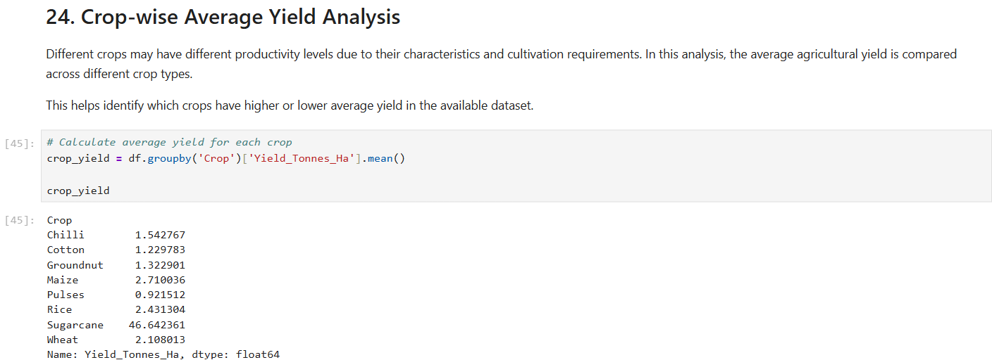
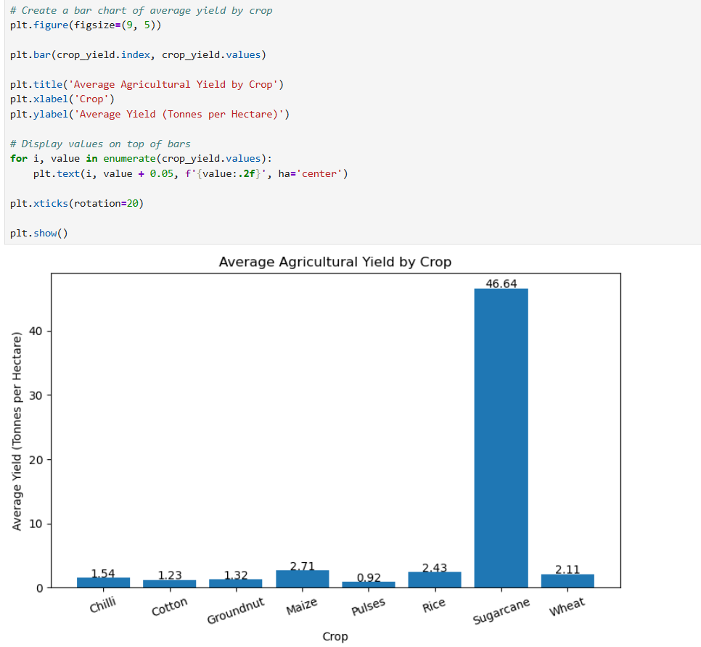
RESULTS
The analysis shows substantial differences in average agricultural yield across different crops.
Sugarcane has the highest average yield at approximately 46.64 tonnes per hectare. Maize has the second-highest average yield at approximately 2.71 tonnes per hectare, followed by Rice at 2.43 tonnes per hectare and Wheat at 2.11 tonnes per hectare.
Among the remaining crops, Chilli has an average yield of approximately 1.54 tonnes per hectare, Groundnut 1.32 tonnes per hectare, and Cotton 1.23 tonnes per hectare. Pulses have the lowest average yield at approximately 0.92 tonnes per hectare.
The results indicate that crop type is associated with substantial differences in average yield in this dataset. Sugarcane shows a particularly high average yield compared with the other crops.
However, the yield values should be interpreted within the context of each crop because different crops can naturally have different production scales and characteristics.

Slide 8
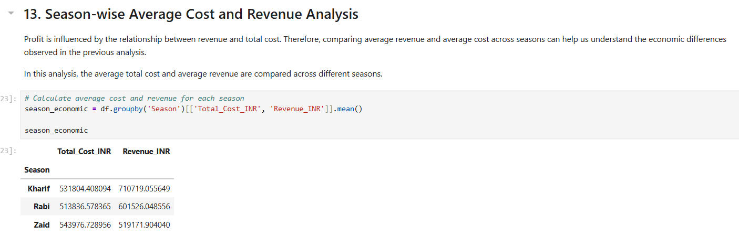
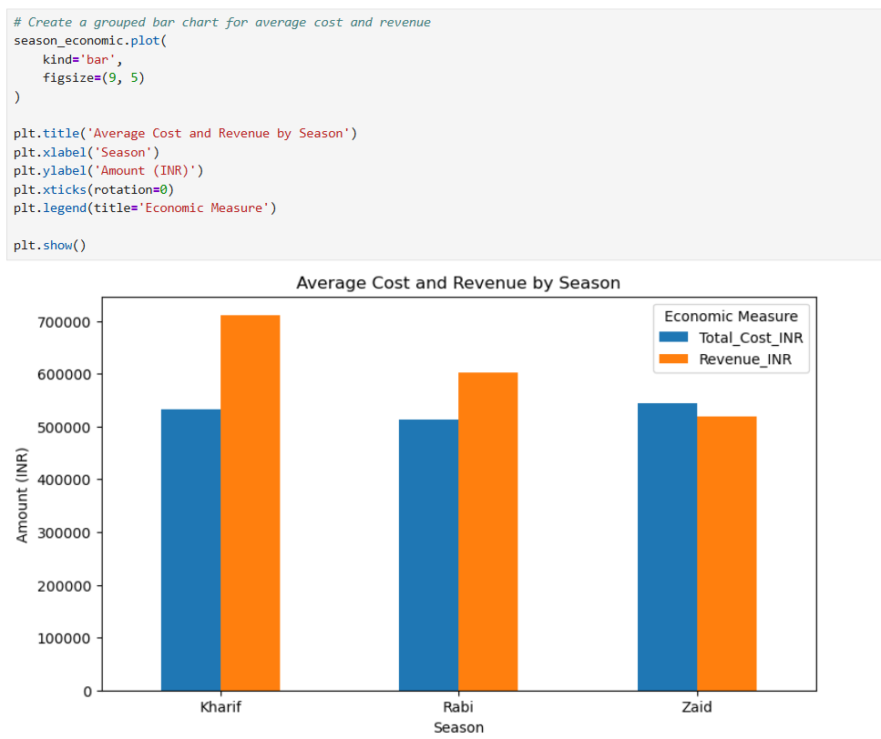
RESULTS
The analysis shows that Kharif has the highest average revenue of approximately ₹710,710, while its average cost is approximately ₹531,804. This results in a positive difference between revenue and cost.
Rabi also has a positive difference between average revenue and average cost, with average revenue of approximately ₹601,526 and average cost of approximately ₹513,836.
In contrast, Zaid has an average cost of approximately ₹543,977, which is higher than its average revenue of approximately ₹519,172. This helps explain the negative average profit observed for the Zaid season in the previous analysis.
Overall, the comparison indicates that the relationship between revenue and cost is an important factor associated with seasonal differences in agricultural profitability.

Slide 9
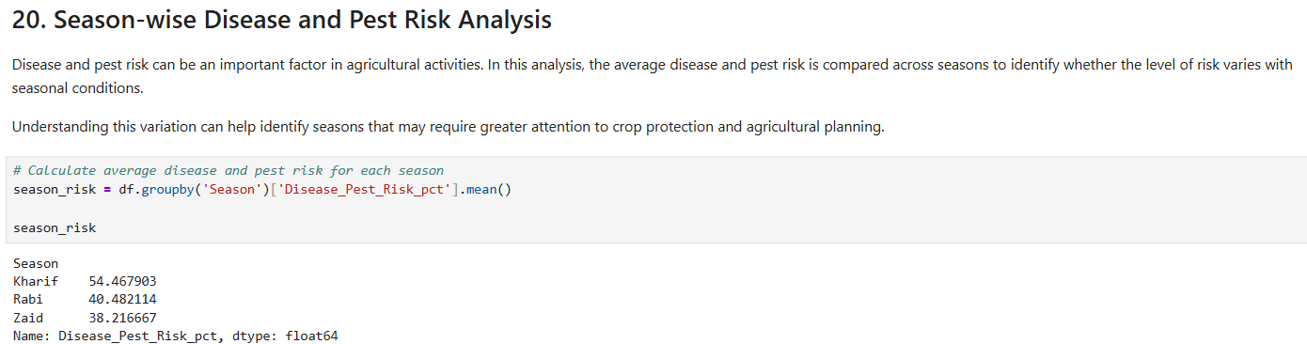
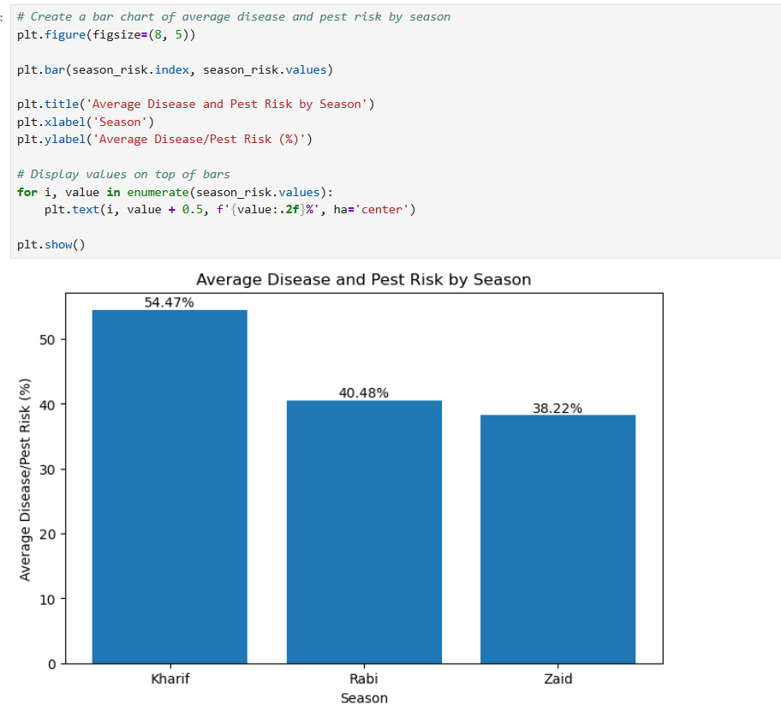
RESULTS
The analysis shows that Kharif has the highest average disease and pest risk at approximately 54.47%, followed by Rabi at approximately 40.48%. Zaid has the lowest average risk at approximately 38.22%.
This indicates that disease and pest risk varies across seasons, with Kharif showing a considerably higher average risk than Rabi and Zaid.
Interestingly, Kharif also recorded the highest average yield, production, and profit in the previous analyses despite having the highest disease and pest risk. Therefore, higher disease and pest risk alone does not appear to explain the differences in agricultural performance observed across seasons.
Further analysis of farming practices, pesticide usage, seed quality, irrigation, and other factors would be required to better understand these differences.

Slide 10
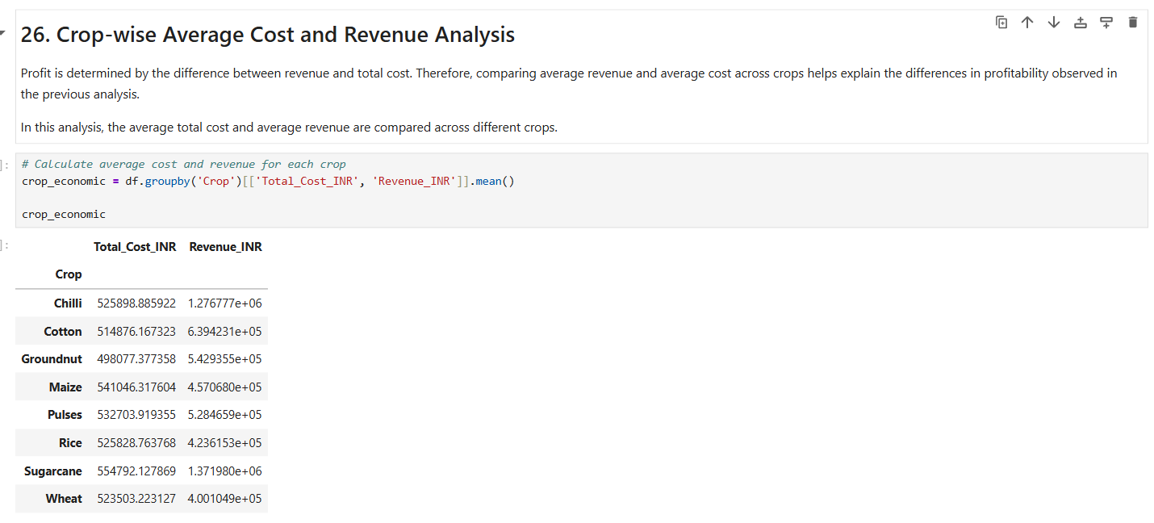
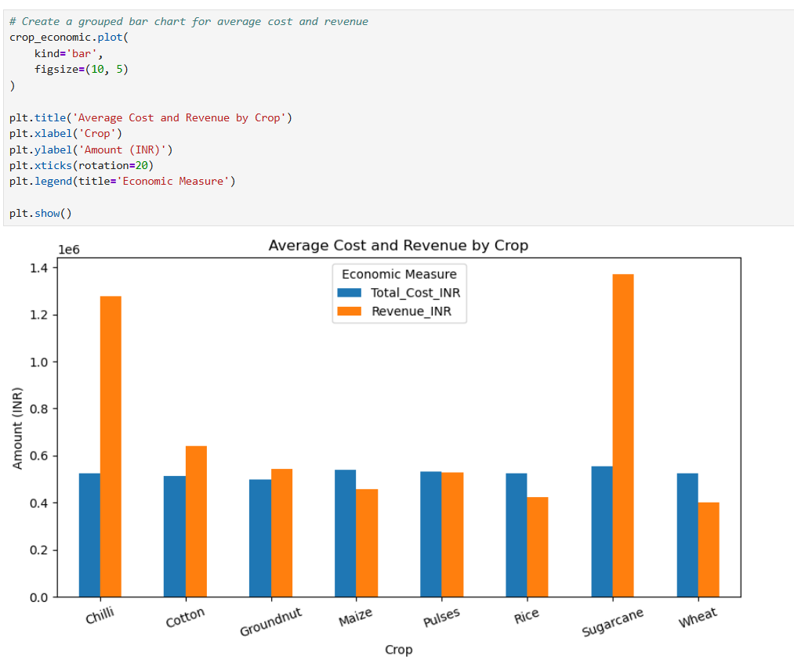
RESULTS
The analysis shows clear differences between average cost and average revenue across crops.
Sugarcane has the highest average revenue at approximately INR 1,371,980, while its average total cost is approximately INR 554,792. This large difference between revenue and cost explains its highest average profit observed in the previous analysis.
Chilli also shows strong economic performance, with an average revenue of approximately INR 1,276,777 compared with an average cost of approximately INR 525,899.
Cotton and Groundnut also have average revenues higher than their average costs, resulting in positive average profits.
In contrast, Maize, Pulses, Rice, and Wheat have average revenues lower than their average total costs. This explains their negative average profits observed in the previous analysis.
Overall, the comparison of average cost and revenue helps explain why profitability differs across crops in the dataset.

Slide 11
Future Scope
Machine Learning Prediction: Predict crop yield and profit using historical agricultural data.
Crop Recommendation System: Recommend suitable crops based on soil, climate, season, and resource conditions.
Regional Decision Support: Develop state/district-specific agricultural recommendations.
Real-Time Data Integration: Integrate live weather, rainfall, market prices, and soil data.
Advanced Statistical Analysis: Use regression and non-linear models to identify relationships that simple correlation may not capture.
Interactive Dashboard: Develop an interactive Power BI or web dashboard for farmers and agricultural departments.
The current project can be extended from descriptive analysis to predictive and prescriptive agricultural decision-making.

Slide 12
GitHub Link
https://github.com/Shubham11-Kumar/seasonal-agriculture-performance-analysis/tree/main

Slide 13

VOIS Course completion certificate Course name- Data Visualization

Slide 14
Thank you
.
.

